Slide 2
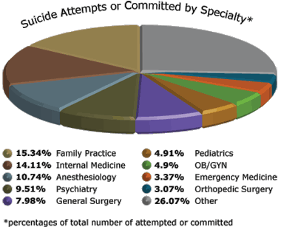
Suicide Chart

Slide 3
3 Reason Why Teens Commit Suicide
1st Reason Of Teens Committing Suicide Is Peer Pressure Its Only So Much A Kid Can Take
2nd Reason Why Teens Might Commit Suicide Is Because Of Bullying People Bully Kids But They Don’t Know What The Kid Is Growing Threw So That Leads Them More Into Committing Suicide
3rd Reason Is Teens Could Be Dealing With A lot At Home Like Divorce , Death In Family , Getting Beat on etc That’s Another Reason Why Teens Commit Suicide

Slide 4
3 Reasons Why Adults Commit Suicide
1st Reason Why Adults Might Commit Suicide Because Of Stress
2nd Reason Why Adults Might Commit Suicide Because Of Being Poor And Living In Poverty
3rd Reason Why Is Because Dealing With Abuse

